Slide 1


Breast Cancer Prediction from Clinical Data
Utilizing Machine Learning Algorithms to predict breast cancer outcomes
AISHWARYA SHASTRY VISWANATH
ANGELA MATOPE

Slide 2
Project Agenda
Overview of objectives and significance of the project
Significance of breast cancer prediction
Overview of the dataset used in the analysis
Data preprocessing techniques
Exploratory Data Analysis
Models selected for prediction
Model results and evaluation
Conclusions
Limitations & Future Work
Q&A

Slide 3


Significance of Breast Cancer Prediction
Breast Cancer is the most common cancer worldwide and is life-threatening (WHO, 2024)
More than 2.3 million new cases each year worldwide
Abnormal growth of breast cells - can affect immune system, brain, lungs
Early detection dramatically improves survival rates
Machine learning can improve diagnosis by identifying cases potentially missed by medical practitioners.
Project objective - develop a machine learning model to support early breast cancer detection.

Slide 4
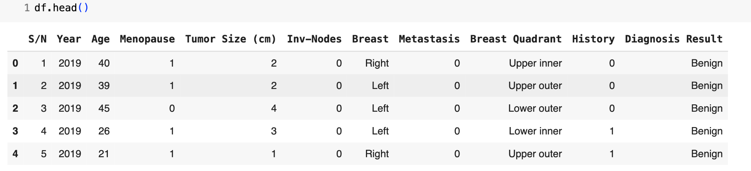

Dataset Overview
Understanding the foundation of our breast cancer prediction
Breast cancer patient records (213) - University of Calabar Teaching Hospital (2019 – 2021) Features included (10) - includes tumor characteristics eg tumor size, metastasis (spread); patient demographics
Target Variable: Diagnosis Result - Benign or Malignant
Benign - non-cancer tumor - slow growth, non-spreading
Malignant - cancer tumor - fast growth, spreading

Slide 5

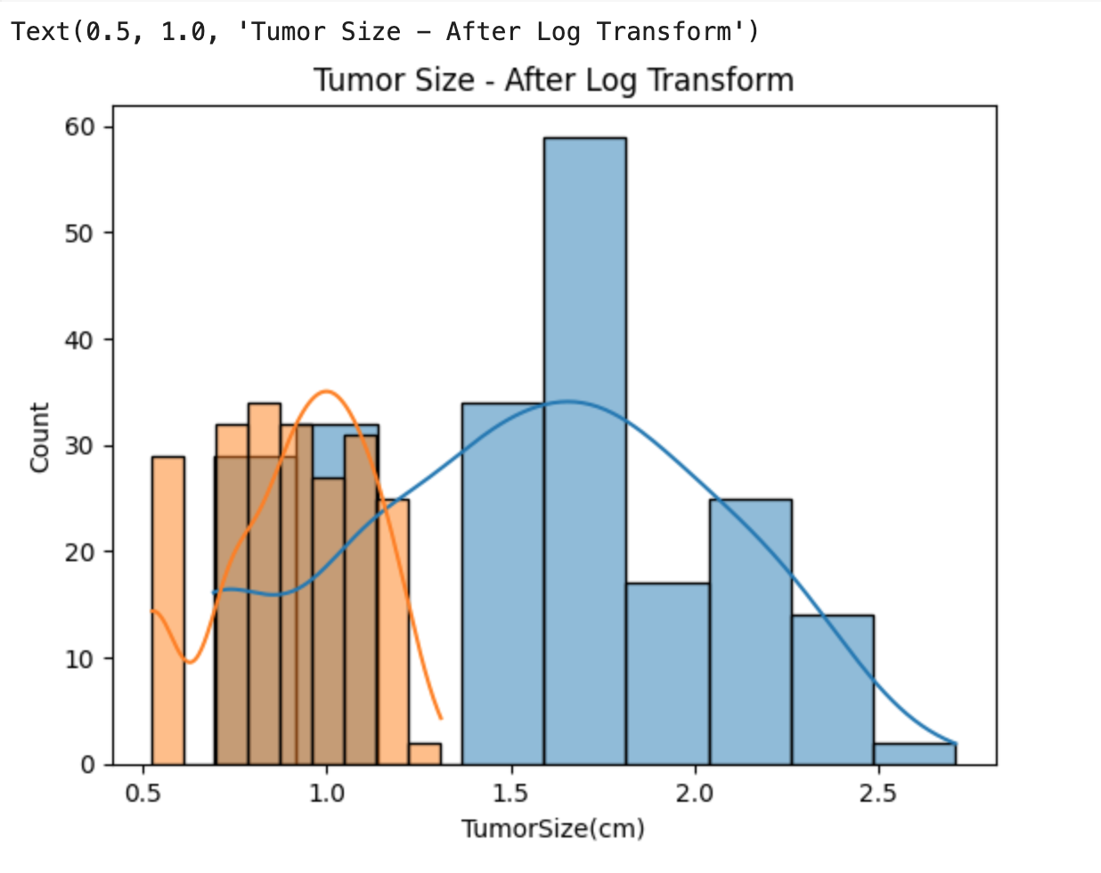
Data Pre-processing Steps and Techniques
Cleaning, standardising, and transforming data to ensure accuracy and consistency
Missing values and outliers replaced by the mean (numeric) and mode (categorical)
Feature scaling - StandardScaler
Encoded categorical variables - One-Hot Encoding
Tumor size was log-transformed to reduce skewness - improves model performance

Slide 6
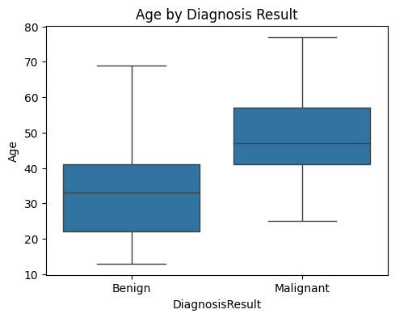
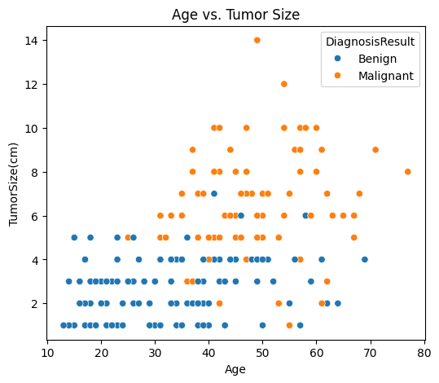
Exploratory Data Analysis
Older individuals (30-70) are generally more impacted by cancer
On average Diagnoses typically occur around the age of 48.

Slide 7
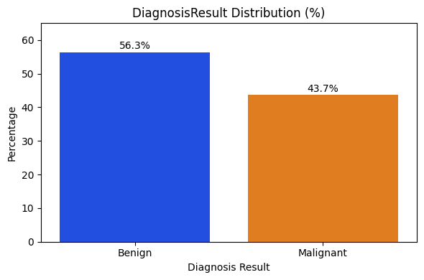
Exploratory Data Analysis
Imbalanced data
Handled using class weighting in models

Slide 8
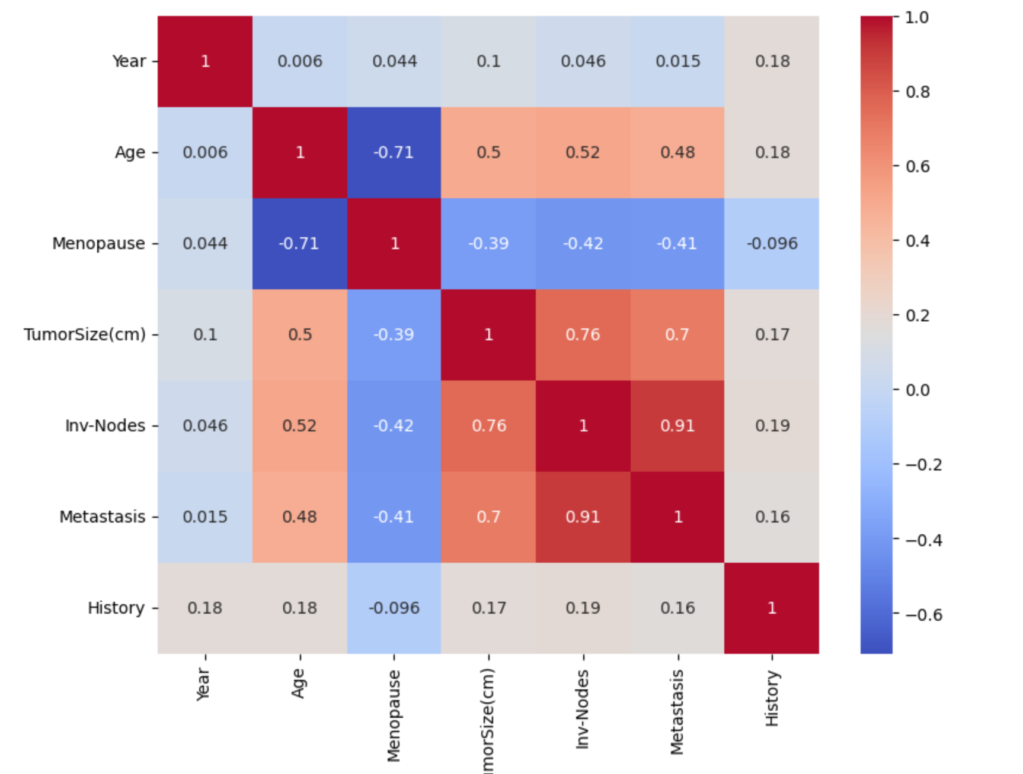
Correlation Heatmap
Positive correlation between features such as age and tumor size, invasive-nodes, and metastasis
Tumor size can indicate the severity of breast cancer and how far it has spread.

Slide 9
Overview of Predictive Models Used
In this section, we discuss the different types of models used in breast cancer prediction. These models include Logistic Regression, Support Vector Machine and the Random Forest Classifier, each offering unique strengths for analyzing and interpreting medical data.
Classification Task:
Predict Diagnosis (Malignant or Benign)

Slide 10

Logistic Regression
Natural and appropriate choice for binary classification
Computational efficiency
Clear insights for medical setting
Model and Algorithm Rationale
Discussing the reasons for our chosen methods
Support Vector Machine
Focuses on improved accuracy especially when classes are close together.
Effective for small datasets with well-defined class boundaries
Random Forest
Capturing potentially complex interactions
Works well with imbalanced and noisy datasets
Its feature importance scores help us understand which clinical factors matter most

Slide 11

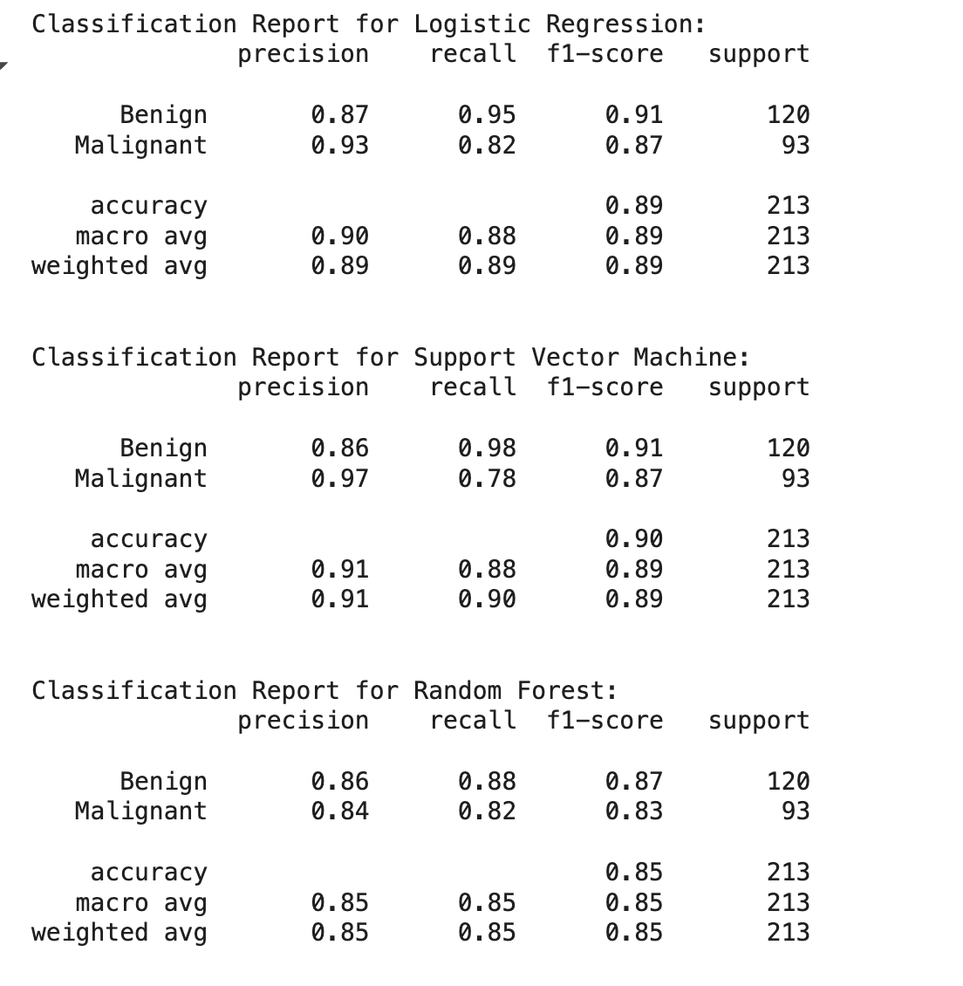
Comparison of Algorithms: Performance Analysis
Analyzing the effectiveness of different algorithms
In this section, we conducted a detailed performance analysis of various algorithms used for breast cancer prediction, focusing on accuracy, precision, and recall metrics to determine which model performs best under specific conditions.

Slide 12
MODEL EVALUATION
 | Predicted Malignant | Predicted Benign
Actual Malignant | True Positive (TP) | False Negative (FN)
Actual Benign | False Positive (FP) | True Negative (TN)
We want to maximize TP and TN and minimize FP and FN.
That’s why we pay close attention to recall — it tells us how good the model is at catching actual malignant cases.”

Slide 13
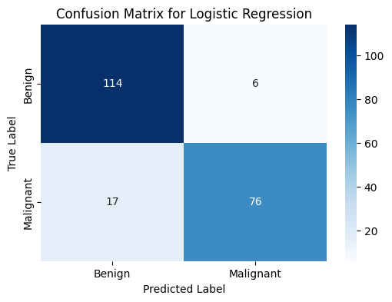
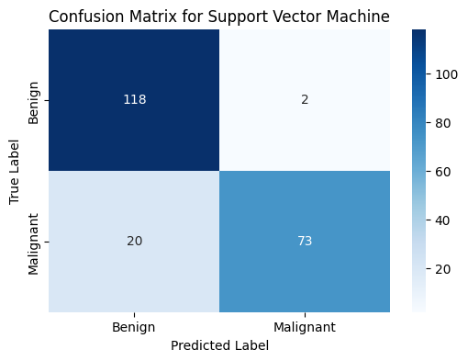
MODEL EVALUATION
The Logistic Regression and Random forest models have slightly fewer false negatives (17) than the SVM (20)

Slide 14
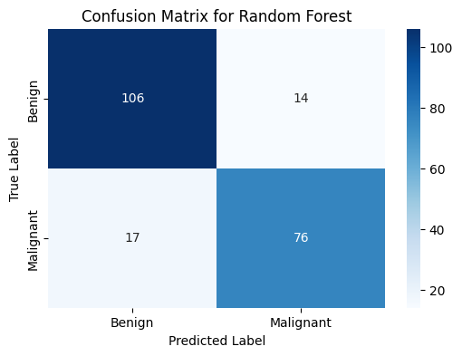
MODEL EVALUATION…
Model | Accuracy | Recall | ROC AUC
Logistic Regression | 84% | 81% | 85%
SVM | 85% | 83% | 87%
Random Forest | 88% | 86% | 91%
Random Forest was the most effective.
Recall is more important — missing a malignant case can be life-threatening
High recall = fewer false negatives (missed malignant tumors)
Random Forest’s balance of precision and recall made it the ideal model

Slide 15
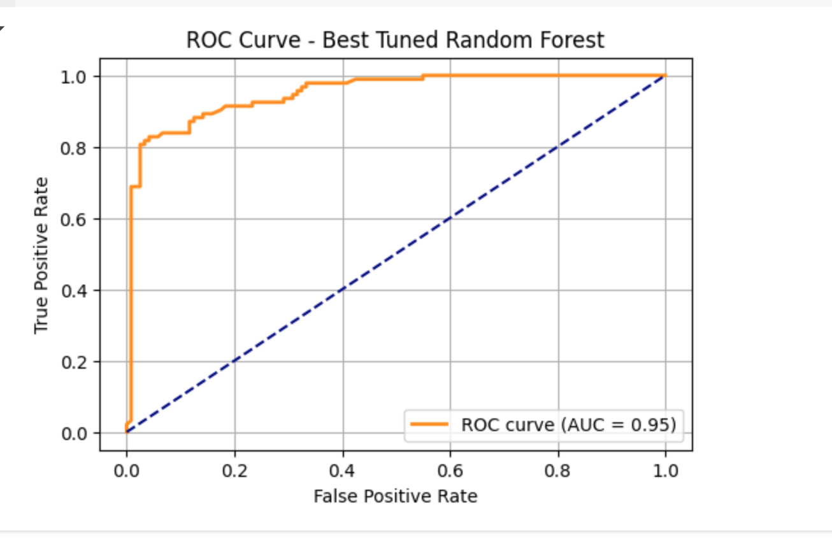
ROC Curve – Best Tuned Random Forest
The ROC (Receiver Operating Characteristic) curve shows the model’s ability to distinguish between classes.
X-axis: False Positive Rate (incorrectly predicted malignant) Y-axis: True Positive Rate (correctly predicted malignant)
A good model’s curve hugs the top-left corner of the plot.
AUC (Area Under the Curve) measures overall model performance.
Our model’s AUC = 0.95, indicating strong classification ability.
This curve helps us see how well the model is separating malignant from benign cases across all thresholds. An AUC of 0.95 shows that our tuned Random Forest performs very well in distinguishing between the two diagnoses.”

Slide 16
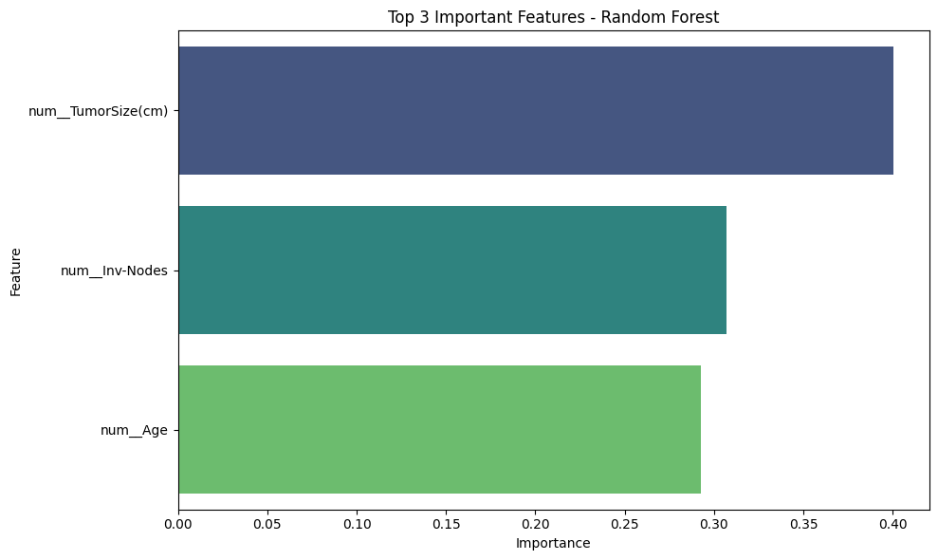
Feature Importance Analysis

Slide 17

Conclusion: Summary of Findings
Key insights and contributions to breast cancer prediction
We developed a predictive model for breast cancer classification using clinical data.
Random Forest (with tuned parameters) was the most effective model.
Top features influencing diagnosis: Tumor Size, Age, Invasive Nodes.

Slide 18

Limitations & Future Work
Exploring challenges and outlining next steps
While our models show promise, data quality and availability remain significant challenges.
Future work will focus on enhancing the dataset and exploring more advanced algorithms to improve prediction accuracy and reliability.
Imaging and genetic data, clinical data can enhance data quality
Future work can incorporate Deep Learning algorithms for complex feature interactions, eg neural networks.

Slide 19

Workload Distribution
Roles and contributions of each team member in project
Data collection and cleaning by Angela
Exploratory Data Analysis by Aishwarya
Data Preprocessing by Angela & Aishwarya
Model selection and pipeline by Angela
Model evaluation and parameter tuning by Aishwarya
Presentation design by Angela & Aishwarya

Slide 20
Q&A
?
?
Breast Cancer Prediction from Clinical Data

